Slide 1
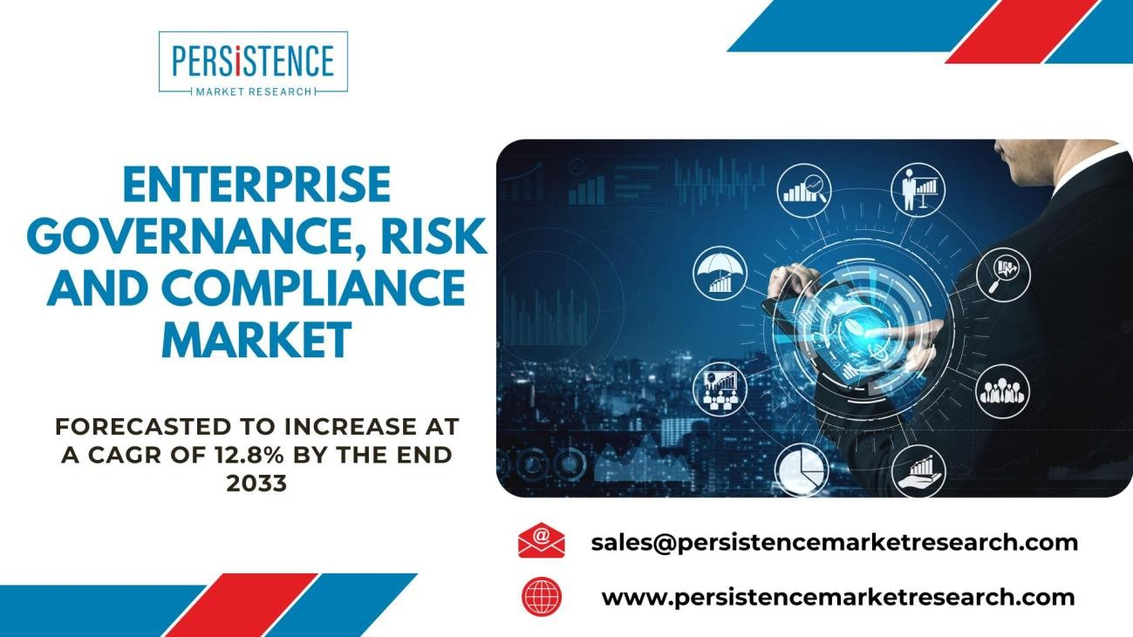
Market Overview
Definition and Scope
Enterprise Governance, Risk, and Compliance (EGRC) encompasses the integrated approach to managing an organization's GRC requirements. It involves the use of technology, processes, and policies to ensure compliance with regulations, mitigate risks, and optimize operational efficiency. EGRC solutions assist in streamlining GRC activities across an organization, reducing the complexity and increasing the effectiveness of managing governance, risk, and compliance.
Market Size and Growth
The EGRC market has exhibited robust growth in recent years due to the increasing complexity of regulations and the need for streamlined compliance processes. According to Persistence Market Research market for enterprise, governance, risk and compliance was valued at US$ 15,233.4 Million in 2022, and by the end of 2033, it is analyzed to have grown to US$ 62,398.4 Million. This market estimated to valuate to US$ 17,101.5 Million in 2023 and predicted to grow with the CAGR of 12.8% during the forecast period of 2023 to 2033.
Request a Sample of the Report Now@ https://www.persistencemarketresearch.com/samples/4754
Market Segmentations:
By Solution :
Software
Audit Management
Risk Management

Slide 2
Business Continuity
Compliance & Policy Management
Information Security & Data Management
Regulatory Change Management
Services
Consulting
Integration & Implementation
Support & Maintenance
By Organization size :
Large Enterprise
Medium Enterprise
Small Enterprise
By Vertical :
Aerospace & Defense
Automotive
Consumer goods & Retail
Healthcare & Life science
ITES & Telecom
Others
By Region :
North America
Latin America
Europe
East Asia
South Asia Pacific
Middle East and Africa
Key Players:
Key players in the EGRC market include,
IBM (US)

Slide 3
Microsoft (US)
Oracle (US)
SAP (Germany)
SAS Institute (US)
Thomson Reuters (Canada)
Wolters Kluwer (Netherlands)
Dell EMC (US)
FIS (US)
MetricStream (US)
Software AG (Germany)
SAI Global (US)
ProcessGene (Israel)
among others.
Market Mergers & Acquisitions (M&A):
In 2022, Oracle Corporation acquired a leading EGRC software provider, strengthening its position in the EGRC market.
IBM Corporation acquired a prominent compliance management solution company to expand its EGRC offerings.
MetricStream acquired a smaller EGRC software vendor to enhance its product portfolio.
SAP SE completed a strategic merger with a specialized EGRC consulting firm to augment its service capabilities.
Drivers & Restraints
Market Drivers for Enterprise Governance, Risk, and Compliance (EGRC) Market:
Regulatory Compliance: Increasingly stringent regulations across industries, such as GDPR and HIPAA, are compelling organizations to invest in EGRC solutions to ensure compliance, driving market growth.
Data Security Concerns: The rising threat of data breaches and cyberattacks has made EGRC solutions essential for safeguarding sensitive information and mitigating risks, fostering market demand.
Cost Reduction: EGRC tools help streamline processes, reduce manual efforts, and enhance operational efficiency, leading to cost savings and stimulating market adoption.

Slide 4
Business Continuity: EGRC solutions are crucial for ensuring business continuity by managing risks and enabling organizations to adapt to changing market dynamics, propelling market growth.
Market Restraints for Enterprise Governance, Risk, and Compliance (EGRC) Market:
Implementation Complexity: Integrating EGRC solutions into existing IT infrastructures can be complex and time-consuming, deterring some organizations from adoption.
High Initial Costs: The initial investment required for EGRC implementation, including software, training, and consultancy services, can be a barrier for smaller enterprises.
Resistance to Change: Resistance within organizations to adapt to new EGRC practices and technologies can impede the adoption of EGRC solutions.
Lack of Skilled Workforce: There is a shortage of professionals with the necessary EGRC expertise, making it challenging for organizations to effectively implement EGRC strategies. This can hinder market growth as well.
Get A Customized Scope To Match Your Need Ask An Expert - https://www.persistencemarketresearch.com/request-customization/4754
Trends Shaping the EGRC Market
The EGRC market is constantly evolving, driven by industry trends and technological advancements. Some of the notable trends shaping this market include:
AI and Machine Learning Integration: EGRC solutions are increasingly incorporating artificial intelligence and machine learning to improve risk assessment, identify compliance violations, and predict potential issues.
Cloud-Based Solutions: The adoption of cloud-based EGRC solutions is on the rise, as they offer scalability, flexibility, and cost-efficiency.
Cybersecurity and Data Privacy Focus: With the growing threat of cyberattacks and the increasing importance of data privacy, EGRC solutions are placing a significant emphasis on cybersecurity and data protection.
Regulatory Technology (RegTech): RegTech solutions are becoming an integral part of EGRC platforms, helping organizations stay compliant with ever-evolving regulations.
Sustainability and ESG Compliance: Environmental, Social, and Governance (ESG) criteria are gaining prominence in EGRC, as companies are increasingly held accountable for their environmental and social impacts.
Vendor Risk Management: EGRC solutions are incorporating advanced vendor risk management capabilities to assess and mitigate risks associated with third-party suppliers and partners.
Challenges in the EGRC Market
Despite the growth and potential of the EGRC market, organizations face several challenges when implementing EGRC solutions:
Data Complexity: The volume and complexity of data that EGRC solutions must manage can be overwhelming, making it challenging to extract valuable insights.

Slide 5
Integration Issues: Integrating EGRC solutions with existing IT systems and processes can be complex and costly.
Change Management: Shifting organizational culture and processes to embrace EGRC practices can be met with resistance, necessitating effective change management strategies.
Compliance Fatigue: Organizations may struggle to keep up with an ever-increasing number
of regulations and compliance requirements, leading to compliance fatigue.
Cost Considerations: The initial investment and ongoing maintenance costs associated with EGRC solutions can be significant, requiring careful financial planning.
Market Trends & Latest Developments:
Increased Focus on Predictive Analytics
Convergence of EGRC and Cybersecurity
Environmental, Social, and Governance (ESG) Integration
Enhanced User Experience and Mobile Accessibility
Emerging Technologies:
Artificial Intelligence and Machine Learning
Blockchain for Data Integrity
Robotic Process Automation (RPA)
Advanced Analytics
Future Projections:
The EGRC market is poised for continued growth in the coming years. The integration of advanced technologies, increased awareness of cybersecurity, and the expanding scope of regulations are expected to be key drivers. Additionally, as sustainability and ESG criteria gain importance, EGRC solutions are likely to adapt to meet the evolving needs of organizations.
Key Offerings in Report:
Comprehensive Market Analysis
Competitive Landscape and Profiles of Key Players
M&A Activities and Strategic Partnerships
Regional Analysis and Market Segmentation
Emerging Technologies and Future Projections
Reasons to Purchase this Report:
Strategic insights for decision-makers
In-depth understanding of market dynamics
Competitive analysis and positioning

Slide 6
Emerging trends and opportunities
Comprehensive regional and segment-wise analysis
Unlock Exclusive Insights into Business Opportunities and Market Value - Get the Premium Insight Now! https://www.persistencemarketresearch.com/checkout/4754
Key Questions Answered in the Report:
What is the current market size and growth potential for EGRC solutions?
Who are the key players in the EGRC market and what are their strategies?
What are the major market segments and their growth prospects?
What M&A activities have shaped the EGRC market in recent years?
How do regional factors impact the EGRC market?
What are the primary drivers of EGRC adoption in organizations?
What are the major challenges faced by EGRC implementations?
What opportunities exist for EGRC solutions in the future?
What are the latest trends and developments in the EGRC market?
What can be expected in the future of the EGRC market in terms of technology and growth?
About Persistence Market Research:
Business intelligence is the foundation of every business model employed by Persistence Market Research. Multi-dimensional sources are being put to work, which include big data, customer experience analytics, and real-time data collection. Thus, working on “micros” by Persistence Market Research helps companies overcome their “macro” business challenges.
Persistence Market Research is always way ahead of its time. In other words, it tables market solutions by stepping into the companies’/clients’ shoes much before they themselves have a sneak pick into the market. The pro-active approach followed by experts at Persistence Market Research helps companies/clients lay their hands on techno-commercial insights beforehand, so that the subsequent course of action could be simplified on their part.
Contact us:
Persistence Market Research
Address – 305 Broadway, 7th Floor, New York City, NY 10007, United States
U.S. Ph. – +1-646-568-7751
USA-Canada Toll-free – +1 800-961-0353 Sales – sales@persistencemarketresearch.com
Website – https://www.persistencemarketresearch.com
LinkedIn | Twitter
This press release first seen on Brilad

